Slide 1

DEEP REINFORCEMENT LEARNING (SLAM)
BTP PRESENTATION
Rajendra Singh
Roll No. 111601017
Computer Science and Engineering
Final Year, IIT Palakkad

Slide 2
Overview of project
What was done
What had left to be done
Improvement
Problem Statement (SI)
Motivation
Algorithms
Implementation
Conclusion
TABLE OF CONTENT
/ 66

Slide 3
Overview of project

Slide 4
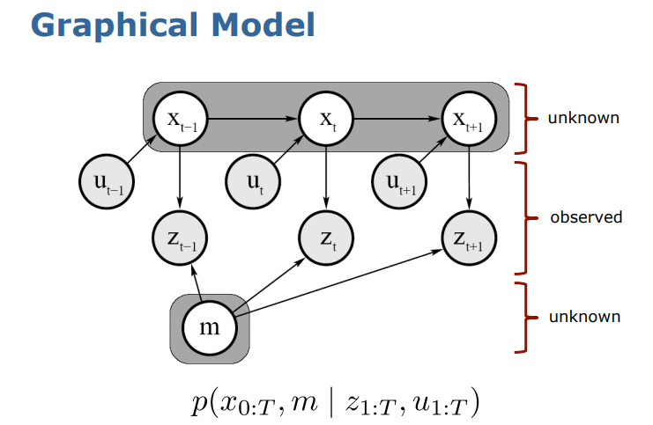
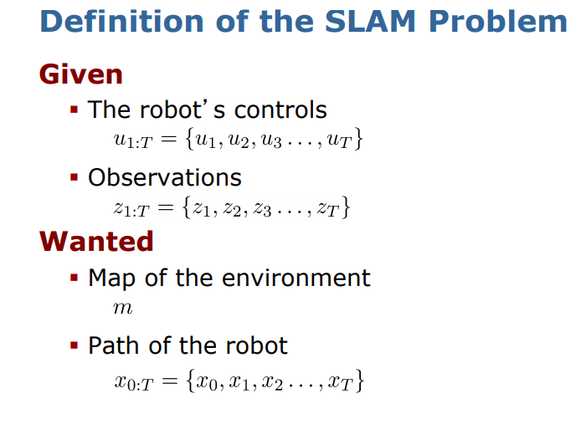
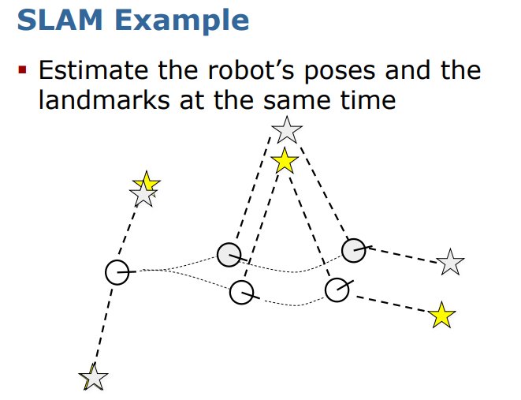
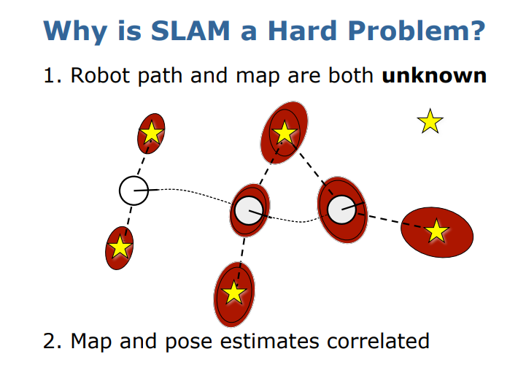
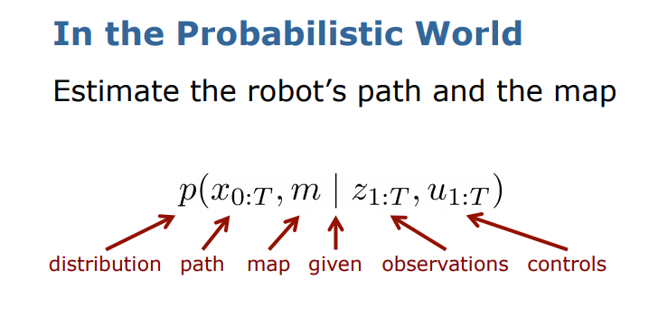
Reference : https://www.mrpt.org/tutorials/slam-algorithms/slam-simultaneous-localization-and-mapping-for-beginners-the-basics/

Slide 5
Hardware Implementation
1
Coordination
Swarm Intelligence, Flocking, Foraging
2
Control
Path planning, PID, RL, A*.
3
Perception
Slam algorithms - Gmapping, RTABMAP, Hector, Karto. (3D cameras, Lidars).
4
SLAM

Slide 6
Perception ??
Slam algorithms - Gmapping, RTABMAP, Hector, Karto. (3D cameras, Lidars).
4
SLAM

Slide 7
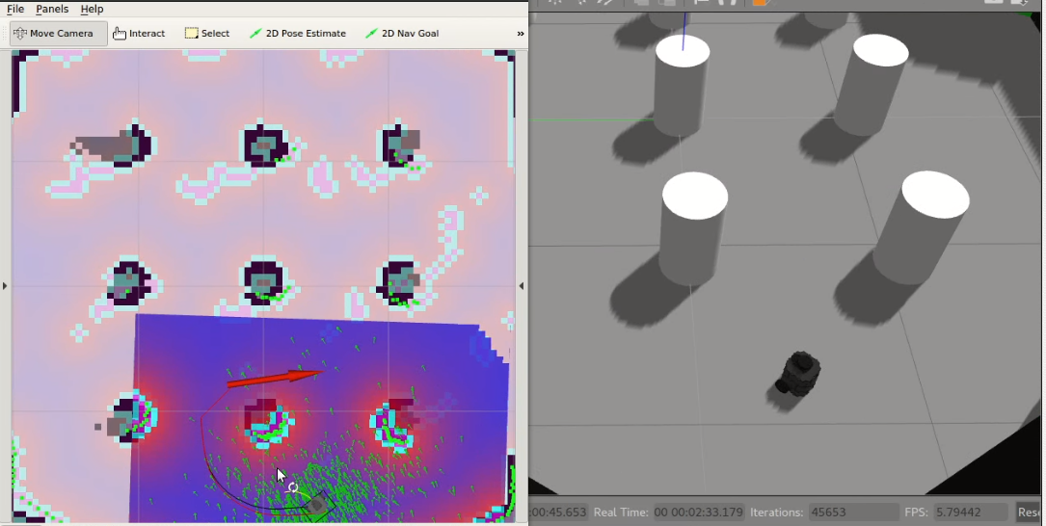
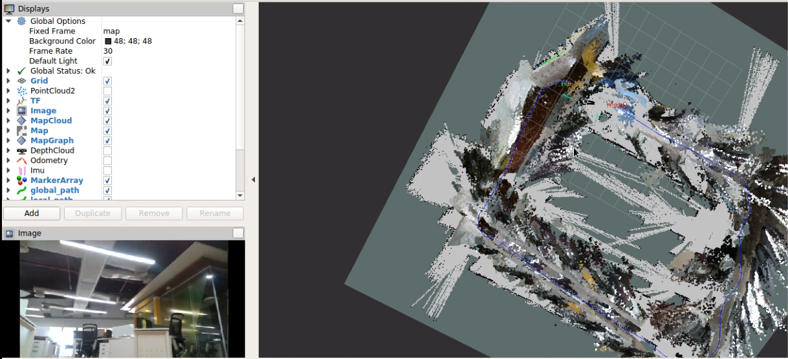
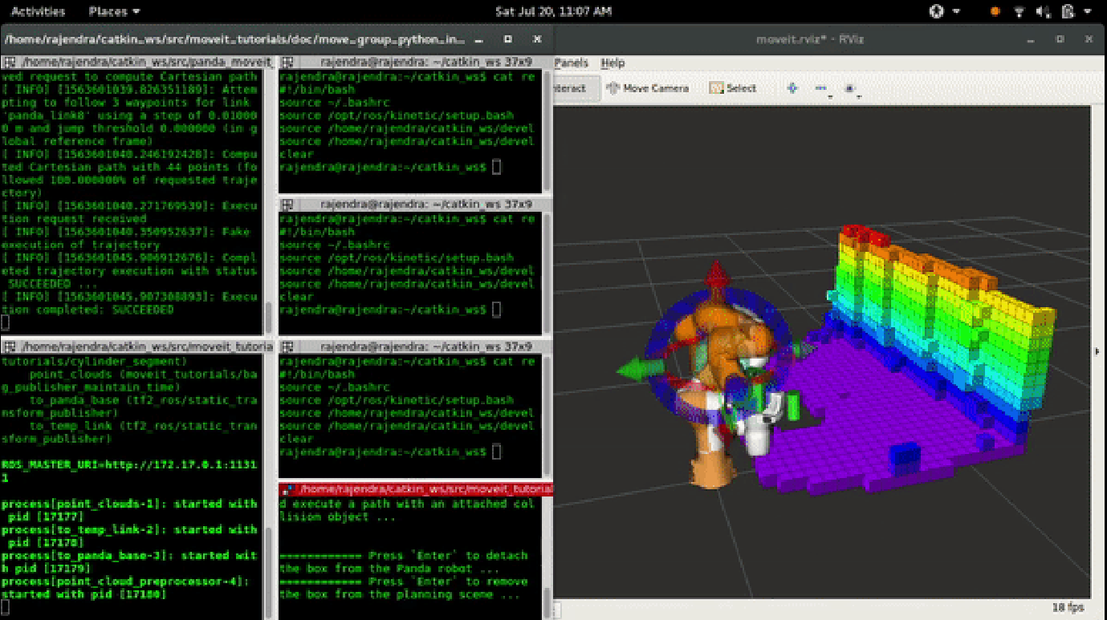
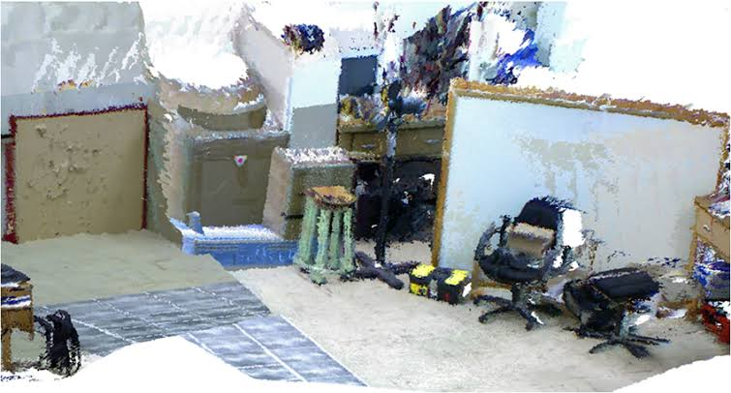
PERCEPTION
GMAPPING
RTABMAP
Point cloud processing
Point cloud Reconstruction

Slide 8
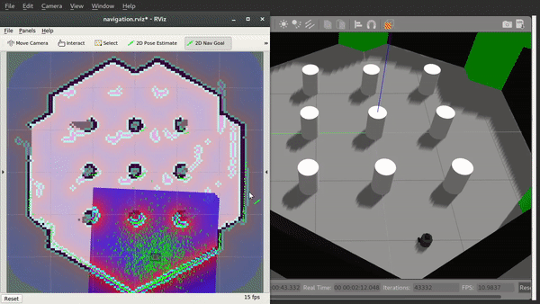
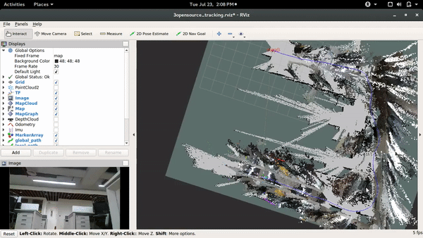
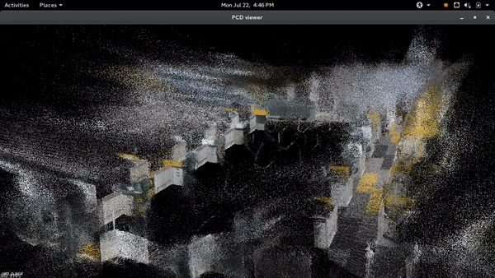
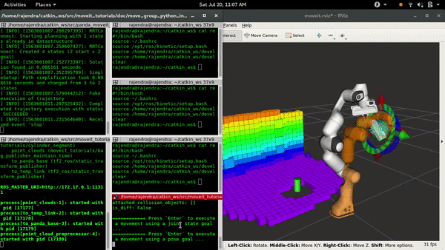
PERCEPTION

Slide 9
Control ??
Path planning, PID, RL, A*.
3
Perception ✓✓
Slam algorithms - Gmapping, RTABMAP, Hector, Karto. (3D cameras, Lidars).
4
SLAM

Slide 10
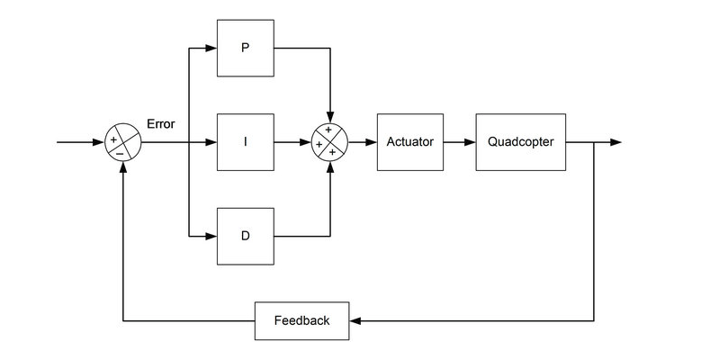
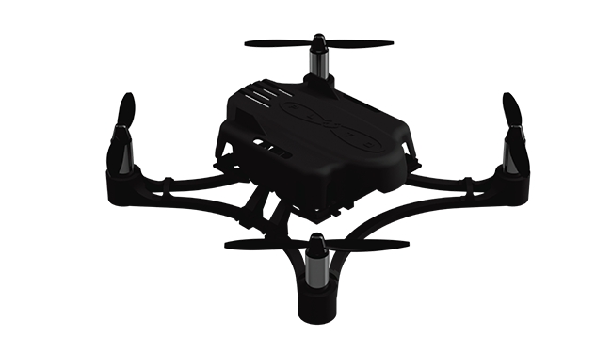
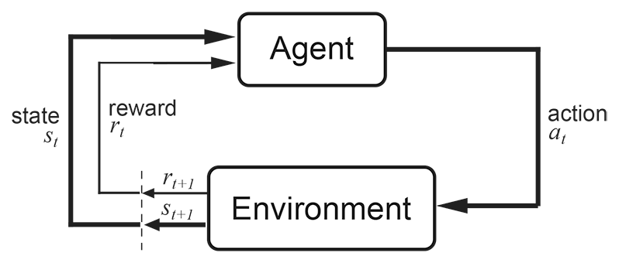
CONTROL
Point B
(End)
Point A
(Start)

Slide 11
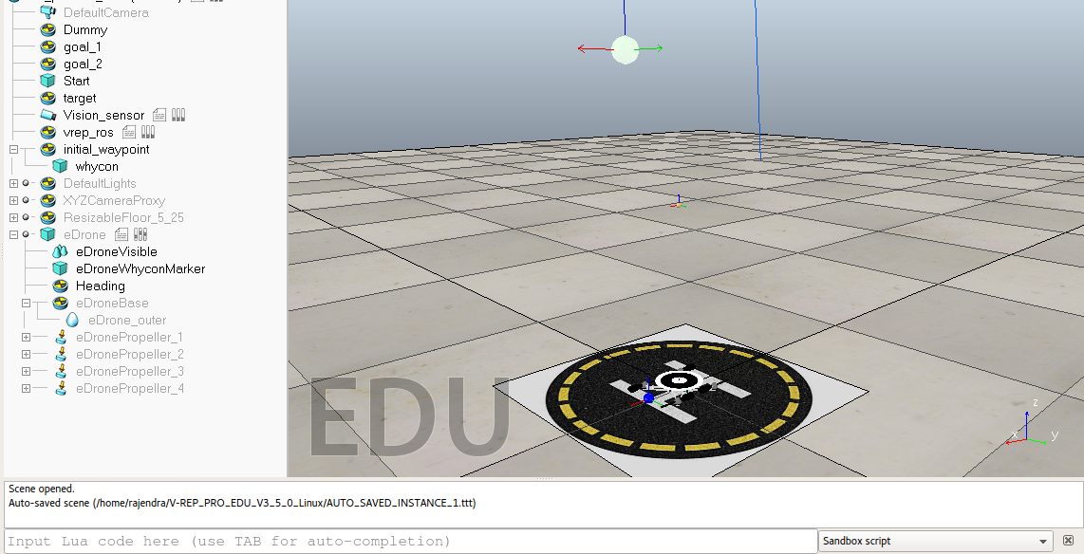
VREP SIMULATION
Pluto Drone

Slide 12
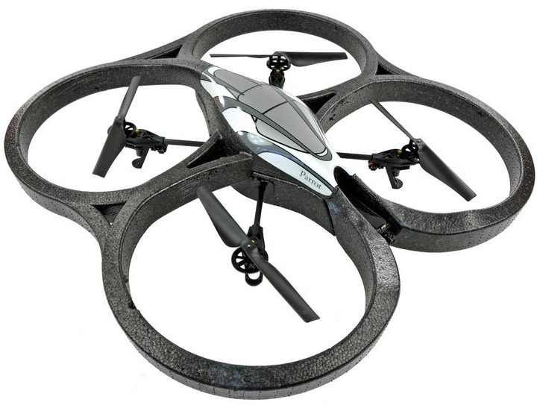
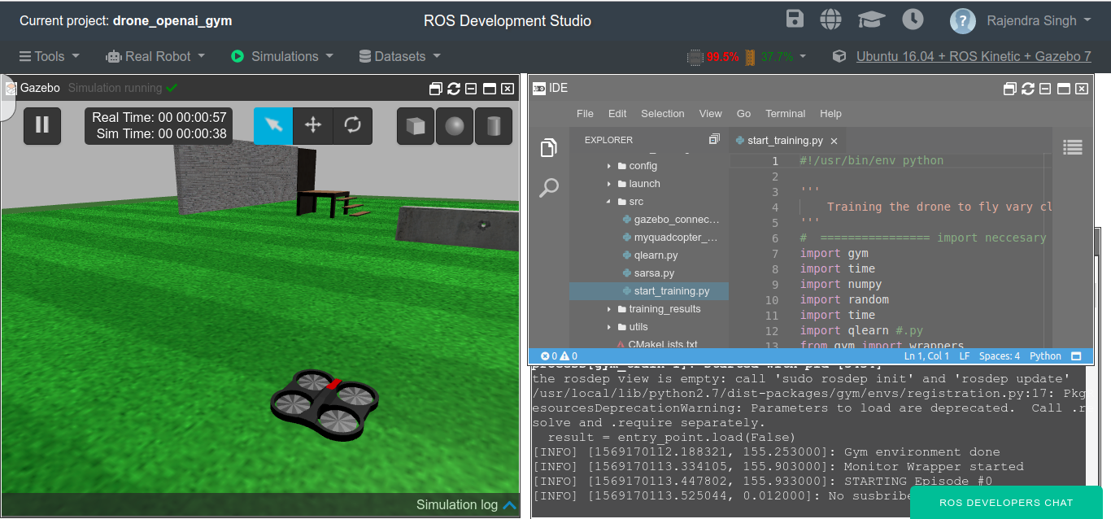
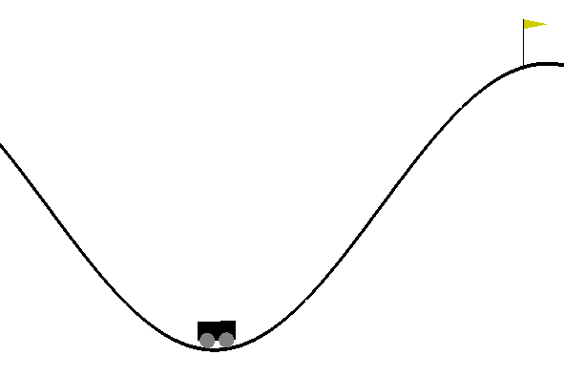
ROS DEVELOPMENT STUDIO
ARdrone
Mountain car

Slide 13
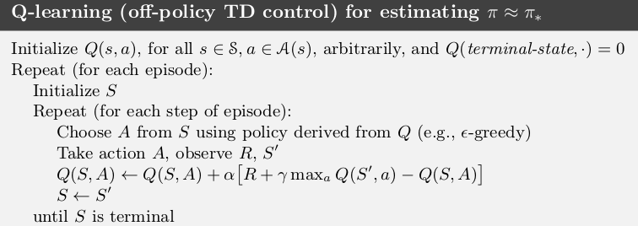
Q-learning
Q[s,a] = lr * Q[s,a] + (1 - lr) * { currentReward + discountFactor * max(Q[s’,:])}
s : given state , a : action(ε-greedy), s’ - next state, lr - learning rate
Ref - https://towardsdatascience.com/reinforcement-learning-temporal-difference-sarsa-q-learning-expected-sarsa-on-python-9fecfda7467e

Slide 14
SARSA

Slide 15
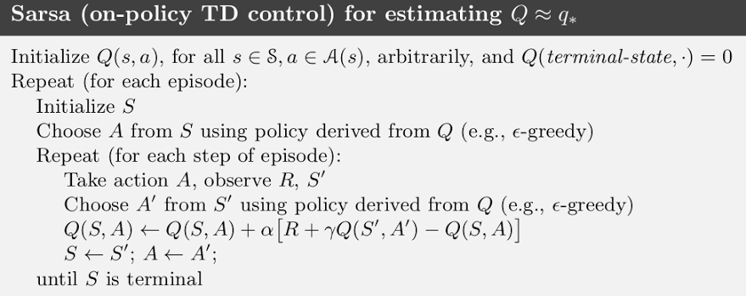
Sarsa
Q[s,a] = lr * Q[s,a] + (1 - lr) * { currentReward + discountFactor * Q[s’,a’] }
s : given state , a : action(ε-greedy), a’ - next action, s’ - next state, lr - learning rate
Ref - https://towardsdatascience.com/reinforcement-learning-temporal-difference-sarsa-q-learning-expected-sarsa-on-python-9fecfda7467e

Slide 16
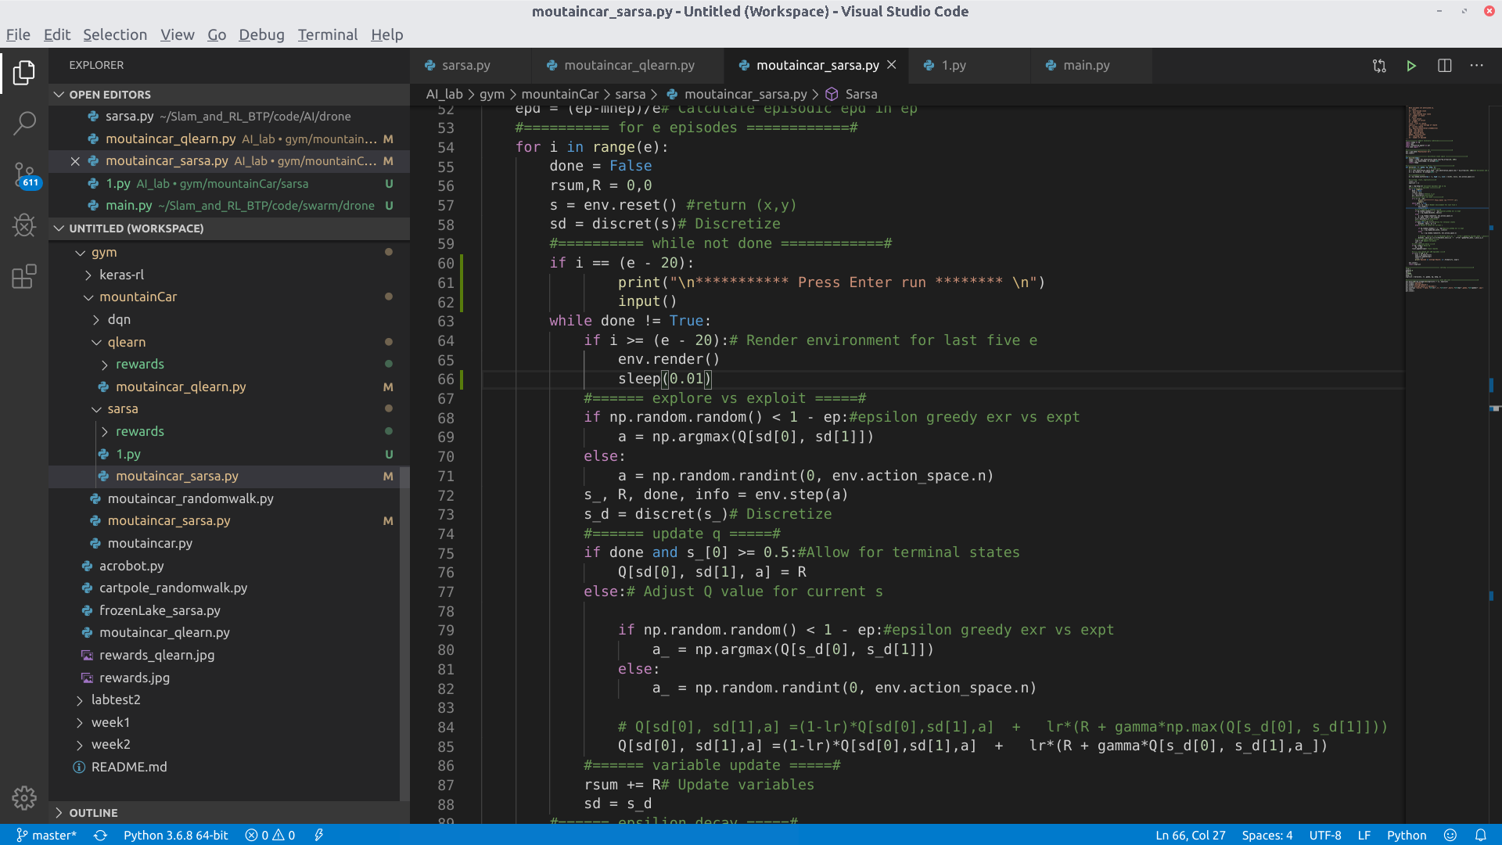
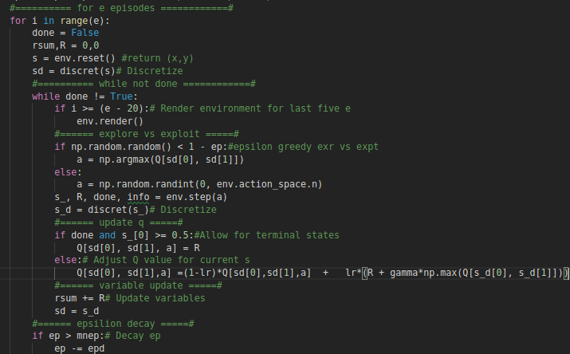

Slide 17
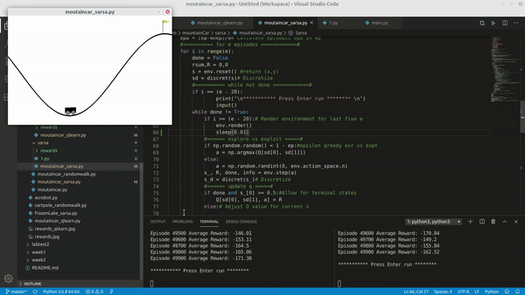

Slide 18
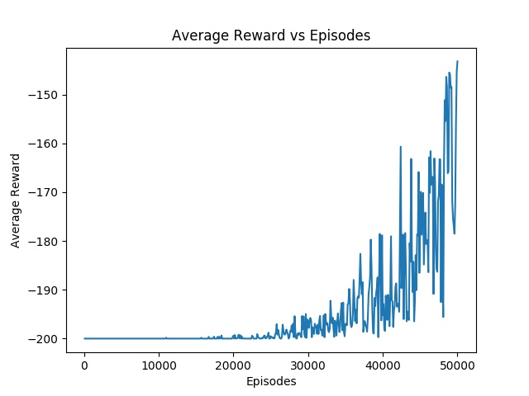
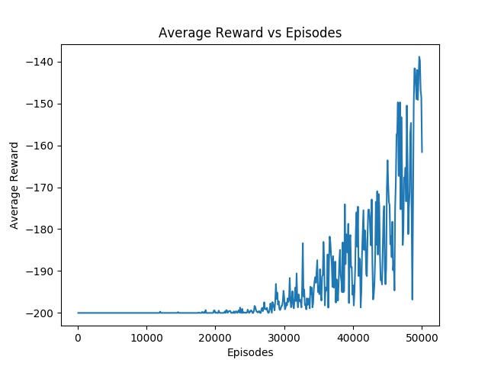
Q-learning
SARSA

Slide 19
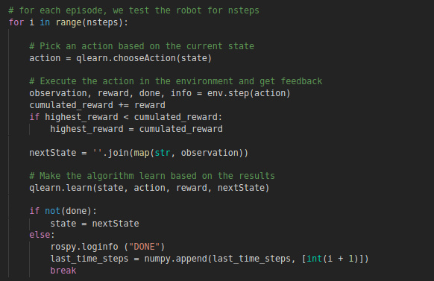
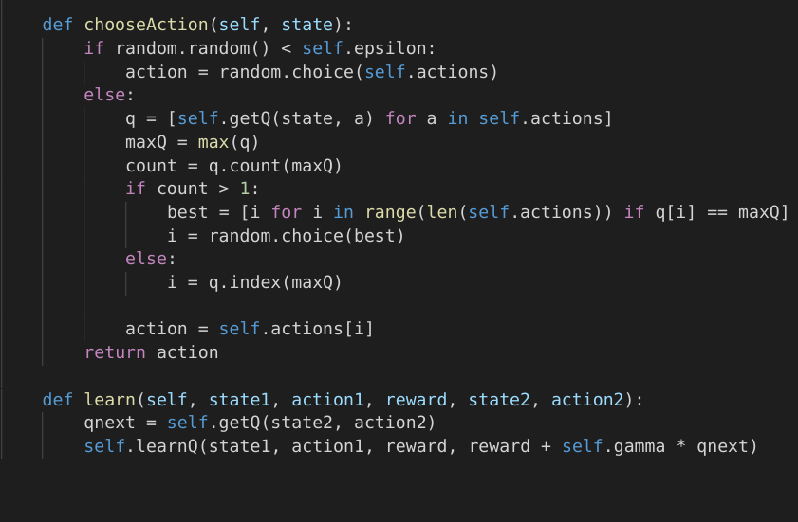
SARSA ON DRONE
TRAINING
SARSA CHOOSE ACTION

Slide 20
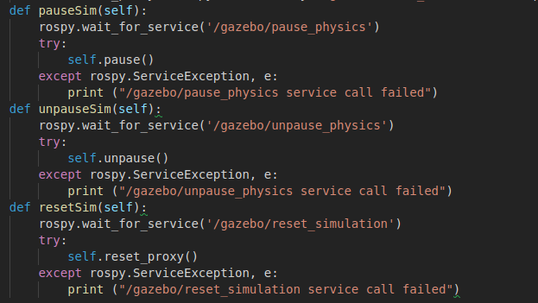
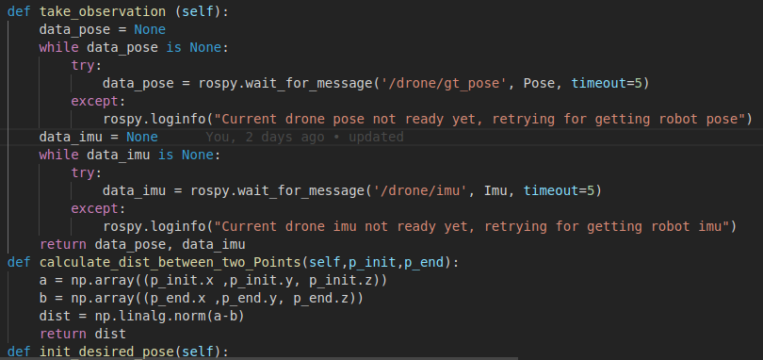
GAZEBO
OPEN GYM ENVIRONMENT

Slide 21
Deep Q-Network (DQN)

Slide 22
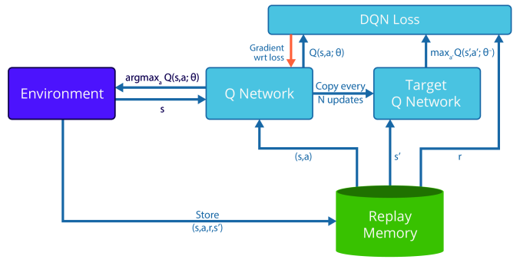
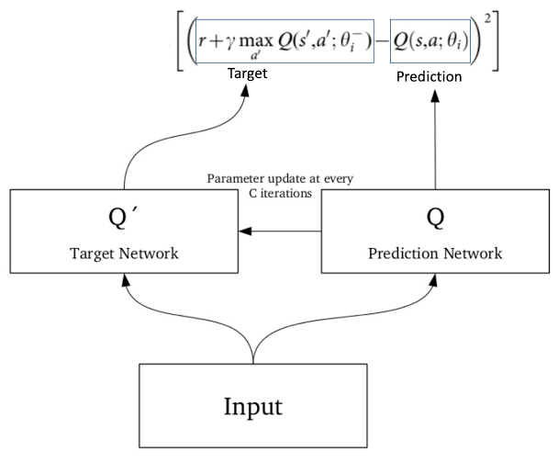
Ref : https://datascience.stackexchange.com/questions/37643/how-to-use-a-different-model-to-deep-neural-network-with-reinforcement-learning

Slide 23
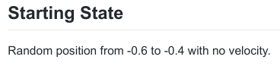

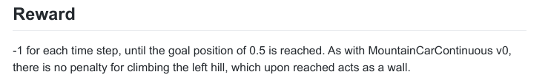
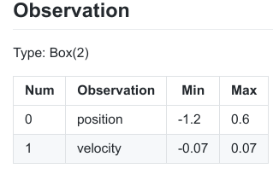
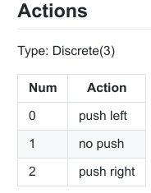
Reference - https://github.com/openai/gym/wiki/MountainCar-v0

Slide 24
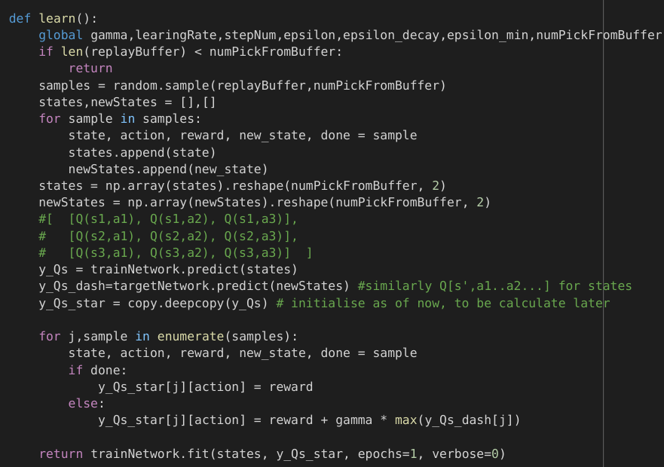
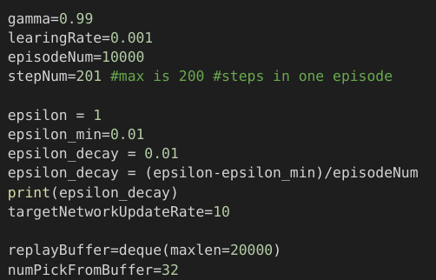
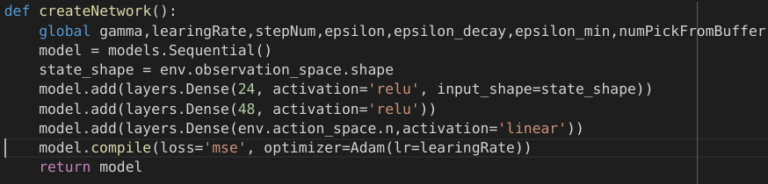
Chosen parameter

Slide 25
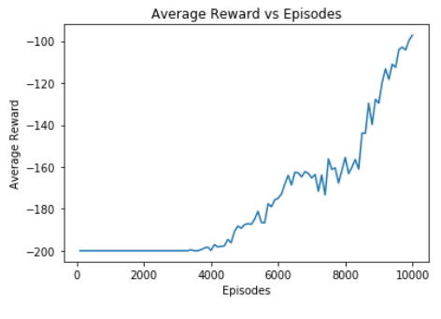
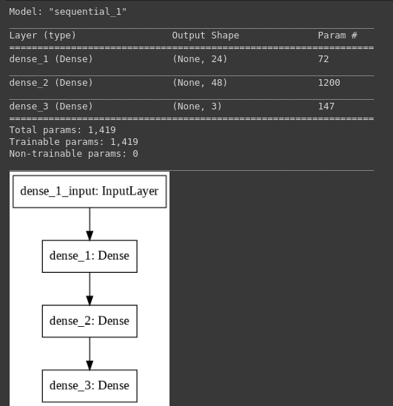
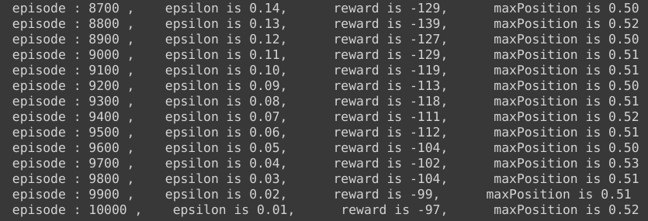

Slide 26
Q-learning
SARSA
DQN

Slide 27
Coordination ??
Swarm Intelligence, Flocking, Foraging
2
Control ✓✓
Path planning, PID, RL, A*.
3
Perception ✓✓
Slam algorithms - Gmapping, RTABMAP, Hector, Karto. (3D cameras, Lidars).
4
SLAM

Slide 28
Claim 1. We need good coordination in robot to perform any real life task !

Slide 29
Experiment 1.

Slide 31
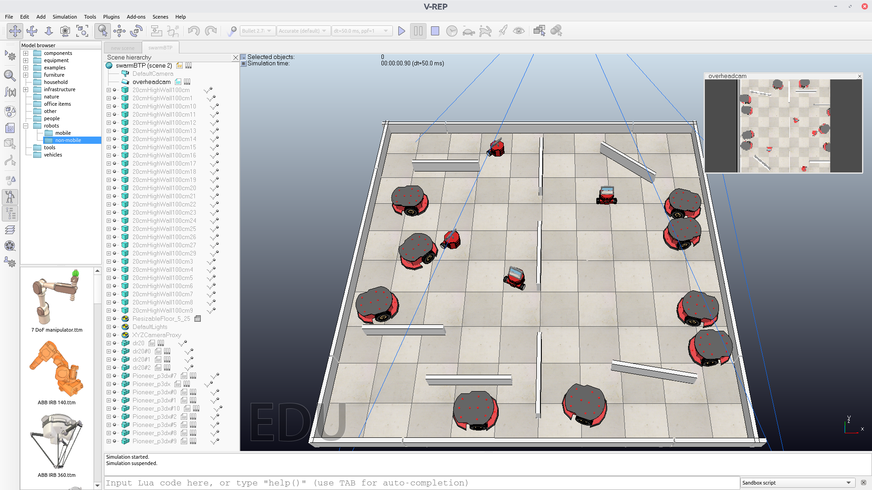

Slide 32
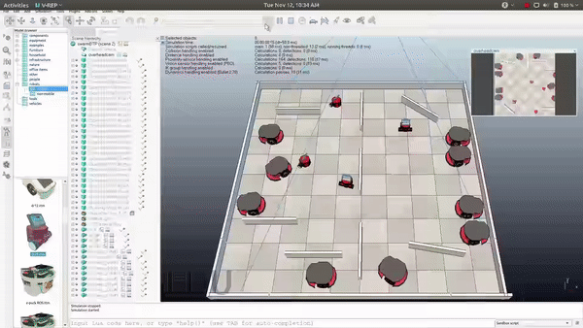

Slide 33
01
No communication
Hence each member need to think for itself
02
Become hurdle for other
Deadlock situation
03
No fast convergence
Even if it work then also it will take time

Slide 34
Claim 2. When I say coordination I doesn’t really mean centralized !

Slide 35
Experiment 2.

Slide 36
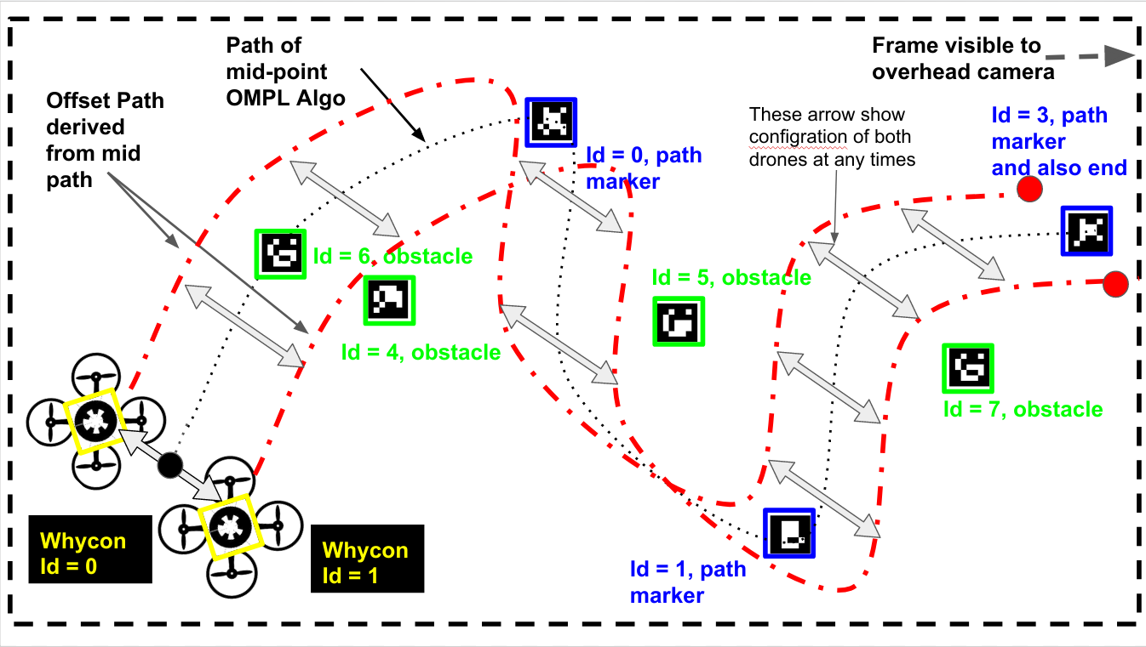

Slide 37
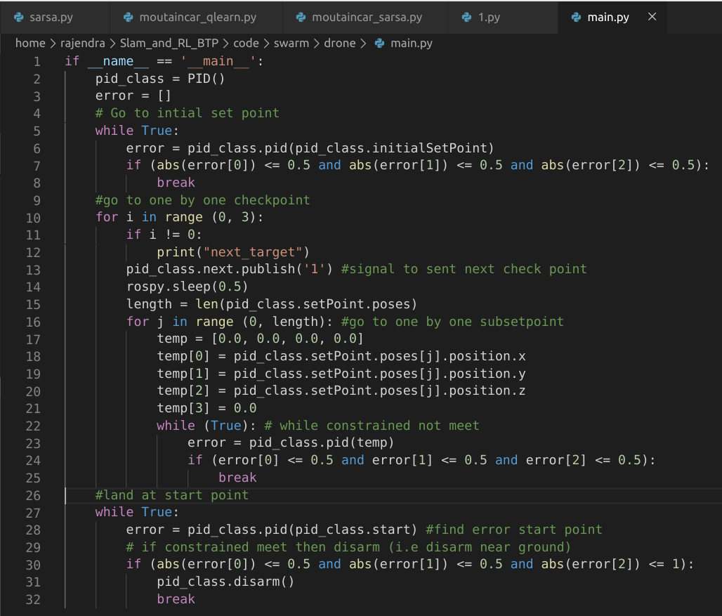
Code
Reference : https://medium.com/better-programming/boids-simulating-birds-flock-behavior-in-python-9fff99375118

Slide 38
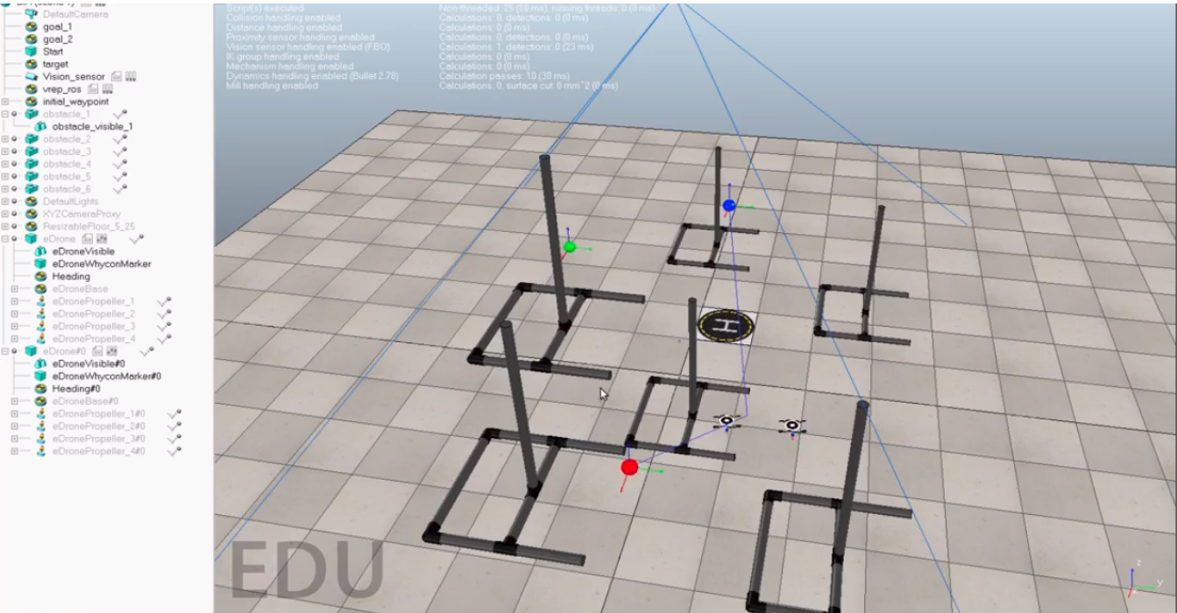

Slide 39
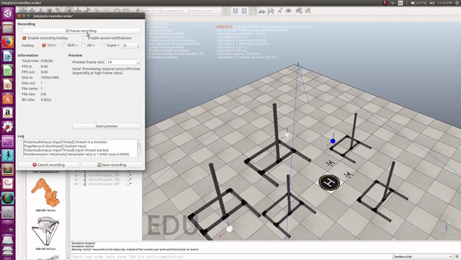

Slide 40
01
When no. for robot increase
Algorithm become complex
02
What if centralise failed
Task failure
03
Incrementing/Decrementing
Have to be monitored

Slide 41
Claim 3. Infact, We need decentralized control!

Slide 42
Algorithm 1.

Slide 43
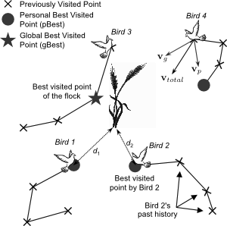

Particle swarm optimization (PSO)
Reference : http://joshkovitz.com/research/projects/optimization-in-electromagnetics/

Slide 44



Reference : https://en.wikipedia.org/wiki/Particle_swarm_optimization

Slide 45

Code

Slide 46




Slide 47








W=0.9, C1=0.5, C2=0.3
W=0.9, C1=0, C2=0.3
W=0.9, C1=0.5, C2=0
W=0, C1=0.5, C2=0.3

Slide 48
PSO in Inverse kinematics (IK)

Slide 49





Slide 50
Experiment 3. Foraging

Slide 51


Slide 52


Slide 53


Slide 54


Slide 55


Slide 56


Slide 57


Slide 58


Slide 59


Slide 60
Code
// ======================== UpdateState() ========================//
/* Read stuff from the ground sensor */
// ==================== CalculateVectorToLight() ==================//
/* Get readings from light sensor, vector returned points to
* the light thus we know if going toward or away from nest. */
// ==================== DiffusionVector() ===================//
/* Get readings from proximity sensor */
// ==================== SetWheelSpeedsFromVector() ===================//
/* Get the heading angle */
/* Finally, set the wheel speeds */
// ==================== Explore() ===================//
/* We switch to 'return to nest' in two situations:
* 1. if we have a food item
* 2. if we have not found a food item for some time;
/* Switch to 'return to nest' */
// ==================== ReturnToNest() ===================//
/* As soon as you get to the nest, switch to 'resting' */
/* Are we in the nest?*/
/* If then Have we looked for a place long enough? */
/* Yes, stop the wheels... */
/* Tell people about the last exploration attempt and switch to state 'resting' else then, keep looking */

Slide 61


Slide 62
Experiment 4. Flocking

Slide 63

Reference : https://software.intel.com/en-us/articles/an-approach-to-parallel-processing-with-unity

Slide 64


Cohesion code

Slide 65


Slide 66


Slide 67


Slide 68
Hardware Implementation ✘✘
1
Coordination ✓✓
Swarm Intelligence, Flocking, Foraging
2
Control ✓✓
Path planning, PID, RL, A*.
3
Perception ✓✓
Slam algorithms - Gmapping, RTABMAP, Hector, Karto. (3D cameras, Lidars).
4
SLAM

Slide 69


Slide 70
3. Conclusion

Slide 71
Progress
Perception ✓✓
Control ✓✓
Coordination ✓✓
Hardware Implementation ✘✘
Done - Feature Detector(ICP, SIFT, SURF),Gmapping, RTABMAP, 3D reconstruction and processing, Feature matching
Not done - Detection, Recognition
Done - PID, Q-learning, Sarsa,DQN
Not done - DQN variants (DDQN,Priortised DQN, Dueling DQN, A3C, Distributionnal DQN, Noisy DQN, Rainbow)
Done - PSO, flocking, foraging
Not done - formation, ACO, MSO
Done - Perception, hovering
Not done - Control, coordination

Slide 72


Effort / Time

Slide 73
Challenges
Battery issue
Simulation (Takes time)

Slide 74
THANK YOU

